Slide 1

Chapter 2 ~ Digital Image Fundamentals
Heaven’s Light is Our Guide
Department of Computer Science & Engineering
Rajshahi University of Engineering & Technology, Rajshahi-6204, Bangladesh.
S. M. Mahedy Hasan
Assistant Professor, Dept. of CSE
RUET, Rajshahi-6204, Bangladesh.

Slide 2
Elements of Visual Perception
Although the field of digital image processing is built on a foundation of mathematical and probabilistic formulations, human intuition and analysis play a central role in the choice of one technique versus another, and this choice often is made based on subjective, visual judgments.

Slide 3
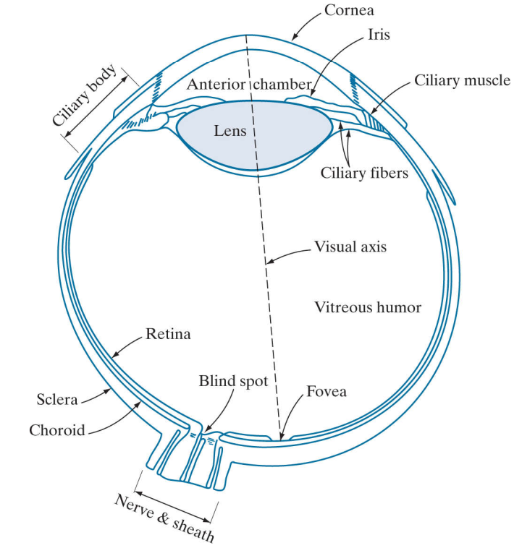
Elements of Visual Perception
Shape: Sphere
Average Diameter: 20mm
Three membranes enclose the eye:
The cornea and sclera outer cover;
The choroid; and
The retina
At Its anterior extreme, the choroid is divided into the ciliary body and the iris.
The central opening of the iris (the pupil) varies in diameter from approximately 2 to 8 mm
Figure 1: Cross section of human eye

Slide 4
Elements of Visual Perception
The lens is made up of concentric layers of fibrous cells and is suspended by fibers that attach to the ciliary body.
It contains 60 to 70% water, about 6% fat, and more protein than any other tissue in the eye.
Figure 1: Cross section of human eye

Slide 5
Elements of Visual Perception
The innermost membrane of the eye is the retina ,which lines the inside of the wall’s entire posterior portion.
When the eye is properly focused, light from an object outside the eye is imaged on the retina.
There are two classes of receptors:
Cones - (6-7 millions)-Sensitive to color
Rods – (75-150 millions)-Highly sensitive to low levels of illumination
Figure 1: Cross section of human eye

Slide 6
Elements of Visual Perception
Scotopic or dim-light vision: Objects that appear brightly colored in daylight when seen by moonlight appear as colorless forms because only the rods are stimulated.
The absence of receptors in this area results in the so-called blind spot.
Except for this region, the distribution of receptors is radially symmetric about the fovea.
Figure 1: Cross section of human eye

Slide 7
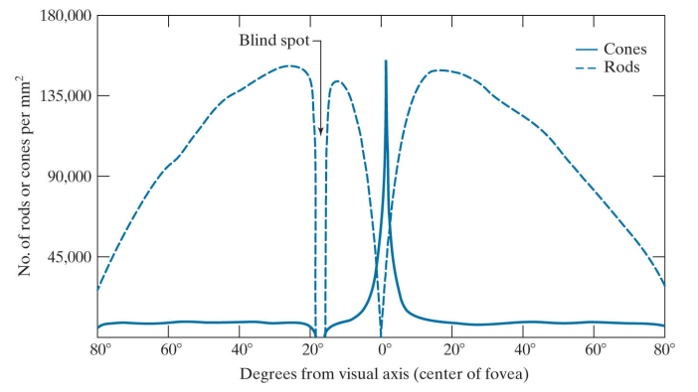
Elements of Visual Perception
Receptor density is measured in degrees from the fovea (that is, in degrees off axis, as measured by the angle formed by the visual axis and a line passing through the center of the lens and intersecting the retina).
Figure 2: Distribution of rods and cones in the retina

Slide 8
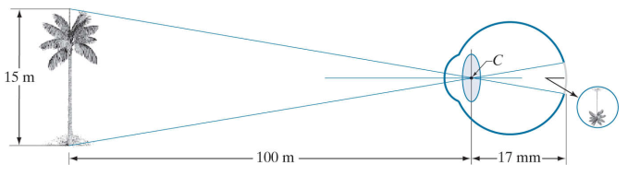
Image Formation in the Eye
Figure 3: Graphical representation of the eye looking at a palm tree. Point C is the focal center of the lens.

Slide 9
Brightness Adaptation and Discrimination
The range of light intensity levels to which the human visual system can adapt is huge (on the order of 10¹⁰) from the scotopic threshold to the glare limit.
Subjective brightness: intensity as perceived by human visual system
Experimental evidence indicates that Subjective brightness is a logarithmic function of the light intensity incident on the eye.
Subjective brightness = log (the intensity inside on the eye)

Slide 10
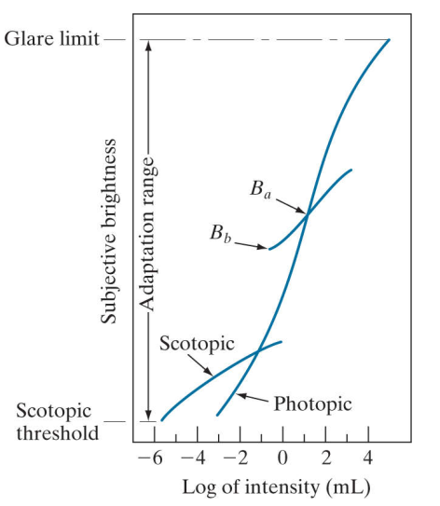
Brightness Adaptation and Discrimination
Figure 4: Range of subjective brightness sensations showing a particular adaptation level

Slide 11
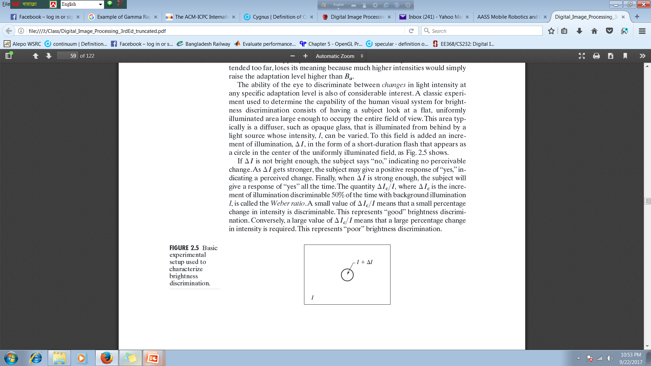
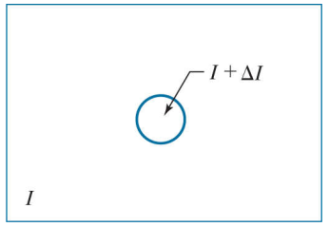
Brightness Adaptation and Discrimination
Figure 5: Basic experimental setup used to characterize brightness discrimination.

Slide 12
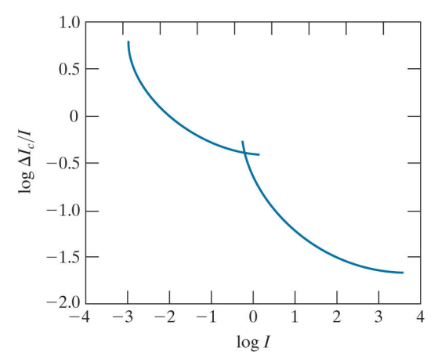
Brightness Adaptation and Discrimination
Figure 6: A typical plot of the Weber ratio as a function of intensity

Slide 13
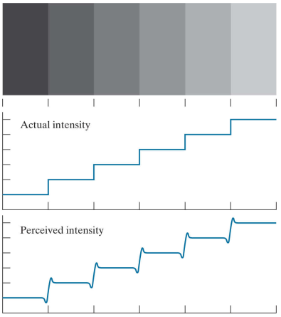
Brightness Adaptation and Discrimination
These seemingly scalloped bands are called Mach bands after Ernst Mach, who first described the phenomenon in 1865.
Figure 7: Illustration of the Mach band effect. Perceived intensity is not a simple function of actual intensity

Slide 14

Brightness Adaptation and Discrimination
Figure 8 :Examples of simultaneous contrast. All the inner squares have the same intensity, but they appear progressively darker as the background becomes lighter.
The second phenomenon, called simultaneous contrast, is related to the fact that a region’s perceived brightness does not depend simply on its intensity, as Figure 8, demonstrates.
All the center squares have exactly the same intensity.
However, they appear to the eye to become darker as the background gets lighter.

Slide 15
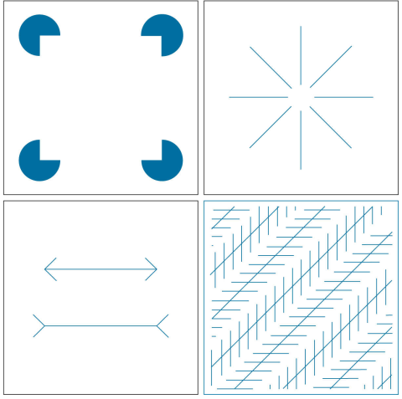
Brightness Adaptation and Discrimination
The outline of a square is seen clearly, despite the fact that no lines defining such a figure are part of the image.
This time with a circle, can be seen.
The two horizontal line segments are of the same length, but one appears shorter than the other.
All lines that are oriented at 45° are equidistant and parallel. Yet the crosshatching creates the illusion that those lines are far from being parallel.
Optical illusions are a characteristic of the human visual system that is not fully understood..…….
Figure 9: Some well-known optical illusions.

Slide 16
Thank You ☺

